Slide 1
Unsupervised Learning & Data Clustering
Problem Set-up
Notes:
Unit 6: Unsupervised Learning & Data Clustering
Module 1: Set-up

Slide 2
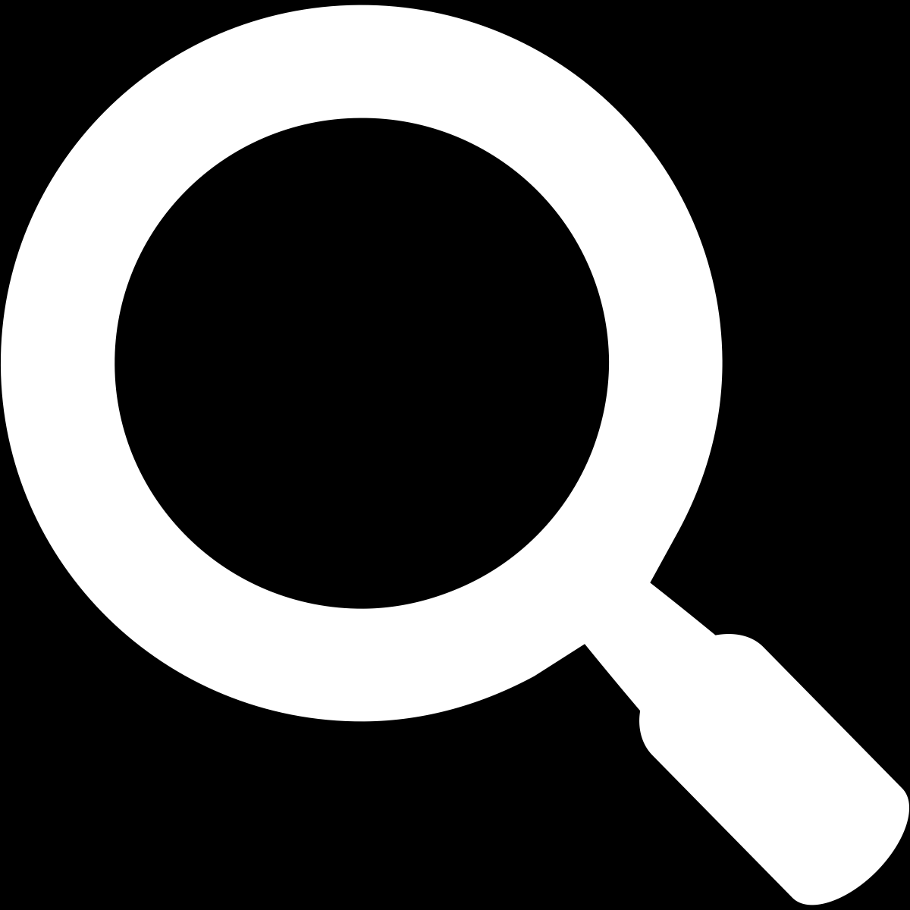
Objective
Objective
Define the set-up of unsupervised learning
Notes:
Module 1: Defining the setup. Discuss the regression task in Supervised Learning)

Slide 3
Learning from Unlabeled Data
Given a training set of n unlabeled samples {x^{(i)}}
What can we learn from the samples?
We could estimate the overall distribution of the data without knowing their label.
We could figure out the groupings of the samples (if any).
We could identify some features that may be more important than others.
Notes:
Provide an example during lecture

Slide 4

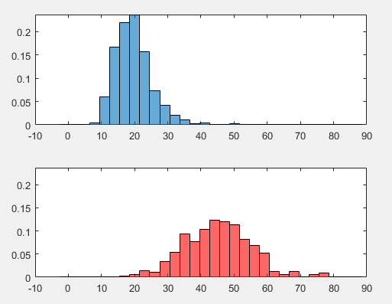
An Example
Illustrating structures/groupings of unlabeled samples may relate to the (unknown) labels of the samples
➔ If we know the labels, we may find the densities of the classes →
➔ What may we see if we have no label for the data samples?
Notes:
Provide an example during lecture

Slide 5
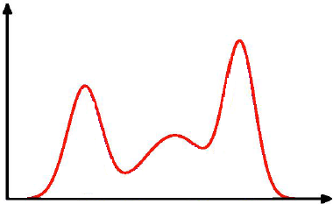
Another Example
A density estimated from unlabeled samples may help us to identify densities of different classes
If we know there are three classes in the data, each having a normal distribution …

Slide 6
A Mixture-Density Model
Assume a parametric model like this:
The samples come from C classes.
The prior probabilities P(ω_{j}) for each class are known, for j = 1, …,C.
The form of p(x | ω_{j}, θ_{j}) (j = 1, …,C) are known.
The C parameter vectors θ₁, θ₂, …, θ_{C} are unknown.
Samples from this distribution are given, but the labels of the training samples are unknown.

Slide 7
A Mixture-Density Model (cont’d)
What is the PDF of the unlabeled samples?
Can we learn θ from unlabeled samples from this mixture density?
where θ = (θ₁, θ₂, …, θ_{C})

Slide 8
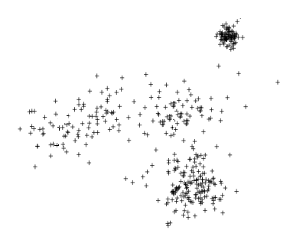
Illustrating Mixture-Density Model
An example: with the assumption of 4 classes

Slide 9
Illustrating Mixture-Density Model
An example: with the assumption of 2 classes

Slide 10
The Question of Identifiability
Can we learn a unique θ from a set of unlabeled samples from a mixture density?
For continuous features (with PDFs), the answer is often “Yes”.
An example in discrete case (with PMF).
Two coins with P(head) being p & q respectively.
Randomly pick one and toss it; Record the outcome.
With only the outcomes of N tosses, but not knowing which coin was used each time (→ unsupervised), can we figure out p and q?

Slide 12
Unsupervised Learning Gaussian Mixture Models and the EM Algorithm
Notes:
Unit 6: Unsupervised Learning
Module 2: GMM & EM

Slide 13
Objective
Objective
Objective
Define the Gaussian Mixture Model
Illustrate the Expectation-Maximization Algorithm
Notes:
Module 2: Defining GMM & an iterative algorithm

Slide 14
The Gaussian Mixture Models
The mixture model:
GMM: each component density is a Gaussian distribution.
Can be a good approximation to many real data distributions.

Slide 15
If We Do Have Labels…
This becomes supervised learning for each component (class).
It is more difficult without labels.

Slide 16
Unsupervised Case
Consider an iterative method using the maximum likelihood estimation concept.
Consider a 3-component 1-d example.
What are the parameters in this case?
We might have some initial (imprecise) guesses for the parameter, e.g., vs the k-means algorithm.
How to improve the initial guesses?

Slide 17

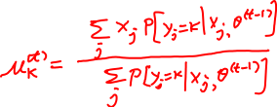
Unsupervised Case (cont’d)
An example of Expectation-Maximization Algorithm.
Iterate on t
Given parameter estimates at iteration t-1
Step 1. For a sample j, compute its probability of being from class k
Step 2. Update the estimates of the parameters

Slide 19
Unsupervised Learning The k-Means Algorithm
Notes:
Unit 6: Unsupervised Learning
Module 3: k-Means Algorithm

Slide 20
Objective
Objective
Objective
Discuss the basics of data clustering
Illustrate the k-Means Algorithm
Notes:
Module 3: Defining the setup. Discuss the regression task in Supervised Learning)

Slide 21
Finding the Clusters/Groupings of the Samples
A few basic questions to answer
How to represent the clusters?
➔ We will use the centroid to represent a cluster.
Which cluster a sample should be assigned to (e.g., membership)?
➔ We will use the similarity to the centroid to determine the membership.
What similarity measure to use?
E.g., Euclidean distance

Slide 22
More on Similarity Measures
If we use Euclidean distance as the measure:
It is invariant to translations & rotations of the feature space.
But not to more general transformations.
E.g., if one feature is scaled.

Slide 23
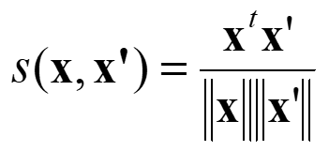
More on Similarity Measures (cont’d)
Other types of similarity measures
E.g., cosine similarity
E.g., distance on a graph, like shortest path.

Slide 24
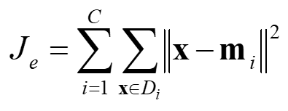
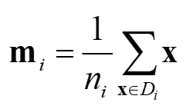

Clustering as Optimization
The sum-of-squared-error criterion/cost
Let D_{i} be the subset of samples from class i.
Let n_{i} be the number of samples in D_{i}, and m_{i} the mean of those samples
The sum of squared error is:
➔ Well-separated, compact data “clouds” tend to give small errors when the clusters coincide with the clouds.

Slide 25
Clustering as Optimization (cont’d)
➔An optimization problem to solve for finding a “good” clustering: to find the partition of the data that minimizes J_{e}
If the membership of a sample is determined by the distance to the means m_{i}
Then the task is to find the optimal set of {m_{i}}
The problem is NP-hard.

Slide 26
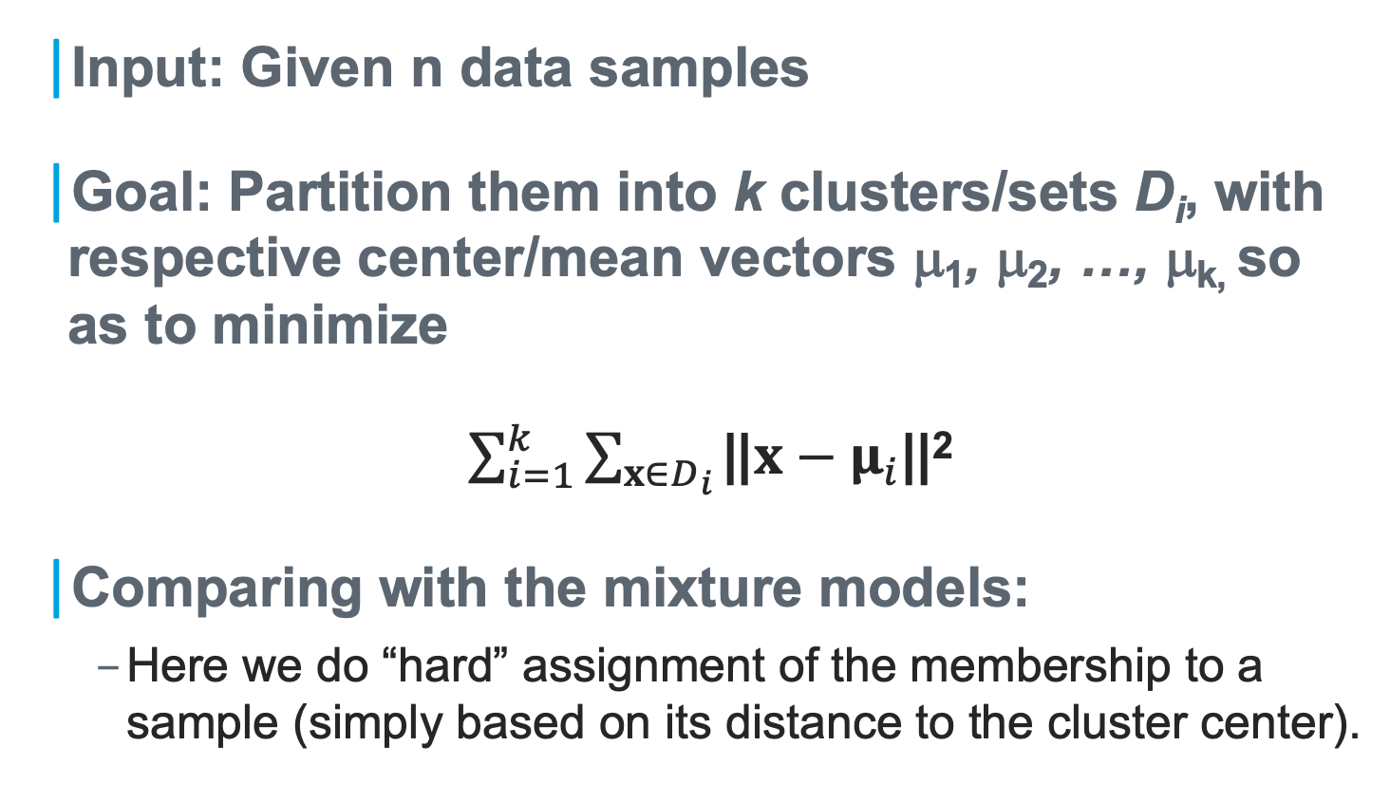
k-Means Clustering
Input: Given n data samples
Goal: Partition them into k clusters/sets D_{i}, with respective center/mean vectors μ₁, μ₂, …, μ_{k,} so as to minimize
$\sum_{i=1}^{k}{\sum_{x∈D_{i}}{\text{||}x−μ_{i}}}$||²
Comparing with the mixture models:
Here we do “hard” assignment of the membership to a sample (simply based on its distance to the cluster center).

Slide 27
The Basic k-Means Algorithm
Given: n samples, a number k.
Begin
initialize μ₁, μ₂, …, μ_{k}(randomly
selected)
do classify n samples according to
nearest μ_{i}
recompute μ_{i}
until no change in μ_{i}
return μ₁, μ₂, …, μ_{k}
End

Slide 28
Illustrating the Algorithm

Slide 30
Unsupervised Learning Analyzing the k-Means Algorithm
Notes:
Unit 6: Unsupervised Learning
Module 4: Analyzing the k-Means Algorithm

Slide 31
Objective
Objective
Objective
Discuss the weaknesses of the k-means algorithm
Discuss a few common techniques for potential improvement

Slide 32
Properties of the k-Means Algorithm
The algorithm will converge when the cluster centers no longer change.
But the results may not be an optimal solution.
➔ Sensitivity to initialization
Notes:
Properties of the k-Means Algorithm

Slide 33
Another Example
What can we do to improve?
The natural grouping seems to be so well defined.
For k=3, what will be the clusters?

Slide 34
A Few Common “Tricks”
Choosing the point furthest from the previous centers.
Drawback: might be sensitive to “outlies”.
Multiple runs with different initial centers.

Slide 35
Other Variants of Basic k-Means
k-Means++:
New centers are chosen with probabilities (as a function of distance to closest prior centers).
Kind of between “random” and “furthest point” techniques.
Hierarchical approaches
Agglomerative vs divisive.

Slide 36
The Question of Choosing k
Two trivial extremes
If k=1, the error is the variance of the samples.
If k=n, the error can become 0.
What is a proper 1<k<n for capturing the structure of the samples?
Some tricks
Trick 1: Will the cost function drop dramatically at some point?
Trick 2: Cross-validation (on, e.g., a classification task)

